Slide 1
Decoding Phone Usage Patterns in India
Prepared By: Manav Patel

Slide 2
Introduction of the Project
In today’s digital landscape, understanding mobile device usage patterns is crucial for business.
So, This project focuses on analysing mobile device usage and user behaviour using structure data which contains the details and information of the customers or users.
So, The core objective of this project include data preprocessing, cleaning and applying machine learning technique such as clustering and classification to uncover meaningful insights.
At the last, make the attractive Streamlit application which include the overview of the project, Exploratory Data Analysis(EDA) and machine learning result.

Slide 3
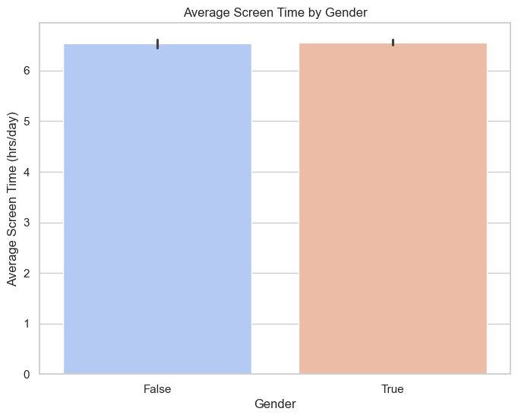
Average Screen Time by Gender
According to the bar plot, the screen time for males and females is almost similar.

Slide 4
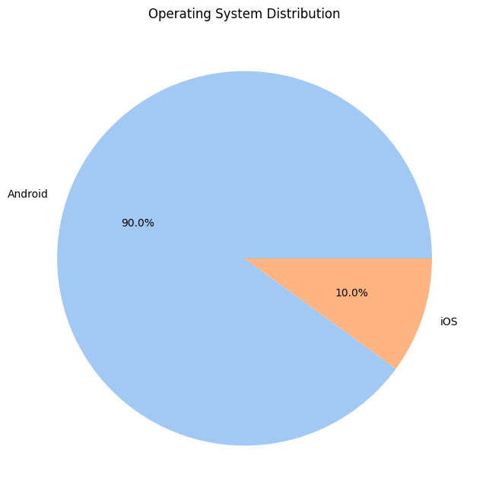
Operating System Distribution
According to the pie chart, 90% of users use Android, while the remaining users use iOS.

Slide 5
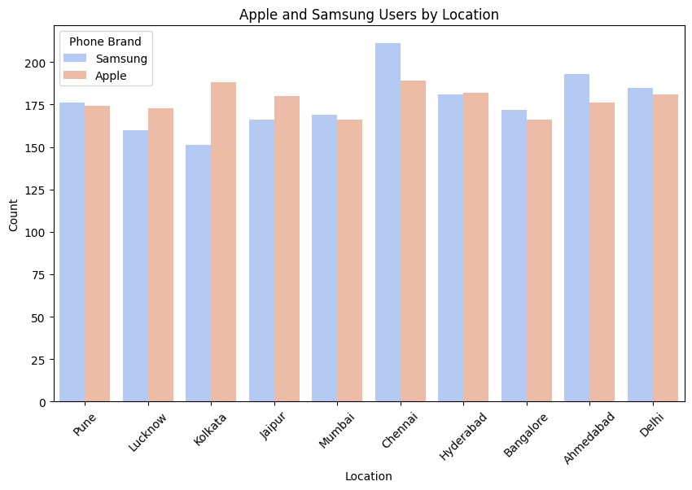
Samsung and Apple user by Location
In most cities, such as Pune, Mumbai, Chennai, Bangalore, Ahmedabad, and Delhi, Samsung users are more prevalent, while in the remaining cities, Apple users are more common.

